Slide 1
Chapter 2 – Software Processes

Slide 2
Topics covered
Software process models
Process activities
Coping with change

Slide 3
The software process
A structured set of activities required to develop a software system.
Many different software processes but all involve:
Specification – defining what the system should do;
Design and implementation – defining the organization of the system and implementing the system;
Validation – checking that it does what the customer wants;
Evolution – changing the system in response to changing customer needs.
A software process model is an abstract representation of a process.

Slide 4
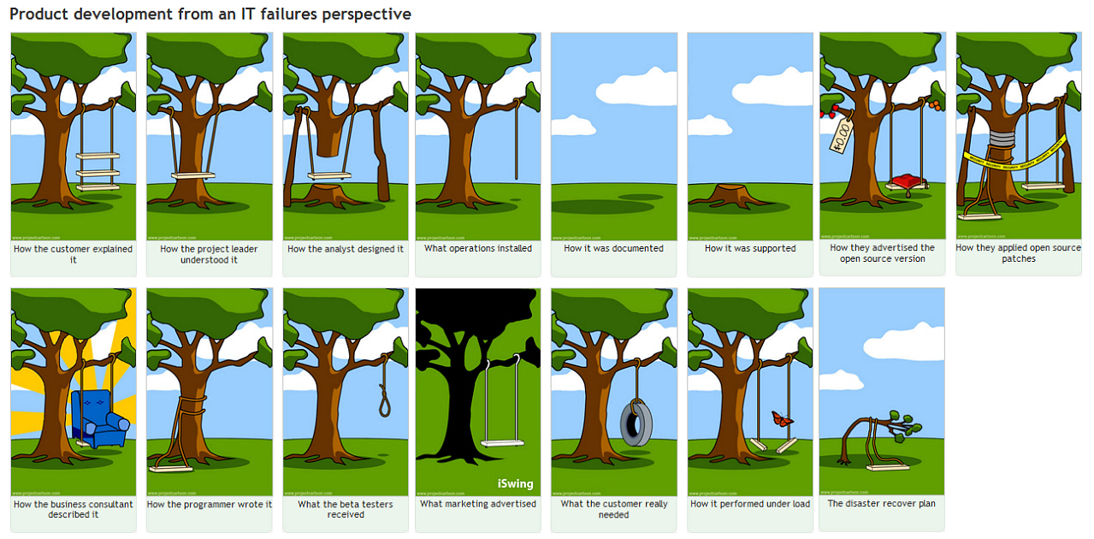
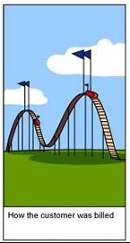

Slide 5
Software process models

Slide 6
Software process models
The waterfall model
Plan-driven model. Separate and distinct phases of specification and development.
Incremental development
Specification, development and validation are interleaved. May be plan-driven or agile.
Integration and configuration
The system is assembled from existing configurable components. May be plan-driven or agile.
In practice, most large systems are developed using a process that incorporates elements from all of these models.

Slide 7
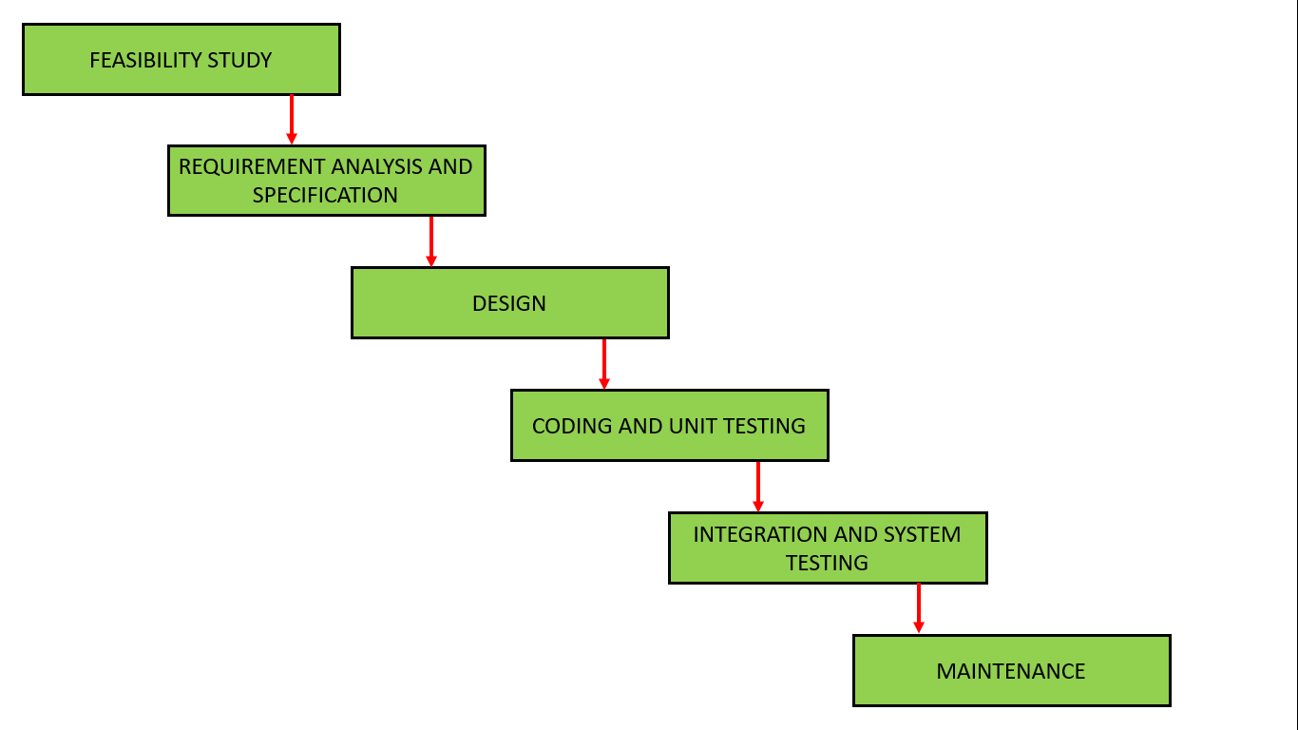
The waterfall model

Slide 8
Waterfall model phases
In the old days, Waterfall model was used to develop enterprise applications like Customer Relationship Management (CRM) systems, Human Resource Management Systems (HRMS), Supply Chain Management Systems, Inventory Management Systems, Point of Sales (POS) systems for Retail chains etc.
The main drawback of the waterfall model is the difficulty of accommodating change after the process is underway. In principle, a phase has to be complete before moving onto the next phase.

Slide 9
Waterfall model problems
Inflexible partitioning of the project into distinct stages makes it difficult to respond to changing customer requirements.
Therefore, this model is only appropriate when the requirements are well-understood and changes will be fairly limited during the design process.
Few business systems have stable requirements.
The waterfall model is mostly used for large systems engineering projects where a system is developed at several sites.
In those circumstances, the plan-driven nature of the waterfall model helps coordinate the work.

Slide 10
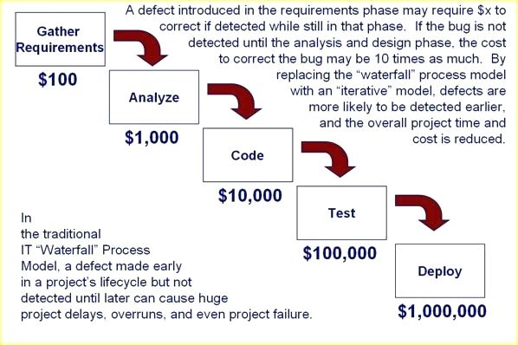
Waterfall model problems

Slide 11
Incremental Development
Incremental development is based on the idea of developing an initial implementation, exposing this to user comment and evolving it through several versions until an adequate system has been developed.
Fundamental part of agile approaches.
Each increment or version of the system incorporates some of the functionality that is needed by the customer.

Slide 12
Incremental development

Slide 13
Incremental development benefits
The cost of accommodating changing customer requirements is reduced.
The amount of analysis and documentation that has to be redone is much less than is required with the waterfall model.
It is easier to get customer feedback on the development work that has been done.
Customers can comment on demonstrations of the software and see how much has been implemented.
More rapid delivery and deployment of useful software to the customer is possible.
Customers are able to use and gain value from the software earlier than is possible with a waterfall process.

Slide 14
Incremental development problems
The process is not visible due to lack of documentation.
Managers need regular deliverables to measure progress. If systems are developed quickly, it is not cost-effective to produce documents that reflect every version of the system.
System structure tends to degrade as new increments are added.
Unless time and money is spent on refactoring to improve the software, regular change tends to corrupt its structure. Incorporating further software changes becomes increasingly difficult and costly.

Slide 15
Integration and configuration
Based on software reuse where systems are integrated from existing components or application systems (sometimes called COTS -Commercial-off-the-shelf) systems).
Reused elements may be configured to adapt their behaviour and functionality to a user’s requirements.
Reuse is now the standard approach for building many types of business system.

Slide 16
Types of reusable software
Stand-alone application systems (sometimes called COTS) that are configured for use in a particular environment.
Collections of objects that are developed as a package to be integrated with a component framework such as .NET or J2EE (e.g. EAR, JAR or WAR files).
Web services that are developed according to service standards and which are available for remote invocation.

Slide 17
Reuse-oriented software engineering

Slide 18
Key process stages
Requirements specification
Software discovery and evaluation
Requirements refinement
Application system configuration
Component adaptation and integration

Slide 19
Advantages and disadvantages
Reduced costs and risks as less software is developed from scratch
Faster delivery and deployment of system
But requirements compromises are inevitable so system may not meet real needs of users
Loss of control over evolution of reused system elements

Slide 20
Process activities

Slide 21
Software specification
The process of establishing what services are required and the constraints on the system’s operation and development.
Requirements engineering process
Requirements elicitation and analysis
What do the system stakeholders require or expect from the system?
Requirements specification
Defining the requirements in detail
Requirements validation
Checking the validity of the requirements

Slide 22
The requirements engineering process

Slide 23
Software design and implementation
The process of converting the system specification into an executable system.
Software design
Design a software structure that realises the specification;
Implementation
Translate this structure into an executable program;
The activities of design and implementation are closely related and may be inter-leaved.

Slide 24
Design activities
Architectural design, where you identify the overall structure of the system, the principal components (subsystems or modules), their relationships and how they are distributed.
Database design, where you design the system data structures and how these are to be represented in a database.
Interface design, where you define the interfaces between system components.
Component selection and design, where you search for reusable components. If unavailable, you design how it will operate.

Slide 25
A general model of the design process

Slide 26
System implementation
The software is implemented either by developing a program or programs or by configuring an application system.
Design and implementation are interleaved activities for most types of software system.
Programming is an individual activity with no standard process.
Debugging is the activity of finding program faults and correcting these faults.

Slide 27
Software validation
Verification and validation (V & V) is intended to show that a system conforms to its specification and meets the requirements of the system customer.
Involves checking and review processes and system testing.
System testing involves executing the system with test cases that are derived from the specification of the real data to be processed by the system.
Testing is the most commonly used V & V activity.

Slide 28
Stages of testing

Slide 29
Testing stages
Component testing
Individual components are tested independently;
Components may be functions or objects or coherent groupings of these entities.
System testing
Testing of the system as a whole. Testing of emergent properties is particularly important.
Customer testing
Testing with customer data to check that the system meets the customer’s needs.

Slide 30
Software evolution
Software is inherently flexible and can change.
As requirements change through changing business circumstances, the software that supports the business must also evolve and change.
Although there has been a demarcation between development and evolution (maintenance) this is increasingly irrelevant as fewer and fewer systems are completely new.

Slide 31
System evolution

Slide 32
Coping with change

Slide 33
Coping with change
Change is inevitable in all large software projects.
Business changes lead to new and changed system requirements
New technologies open up new possibilities for improving implementations
Changing platforms require application changes
Change leads to rework so the costs of change include both rework (e.g. re-analysing requirements) as well as the costs of implementing new functionality

Slide 34
Coping with changing requirements
System prototyping, where a version of the system or part of the system is developed quickly to check the customer’s requirements and the feasibility of design decisions. This approach supports change anticipation.
Incremental delivery, where system increments are delivered to the customer for comment and experimentation. This supports both change avoidance and change tolerance.

Slide 35
Software prototyping
A prototype is an initial version of a system used to demonstrate concepts and try out design options.
A prototype can be used in:
The requirements engineering process to help with requirements elicitation and validation;
In design processes to explore options and develop a UI design;
In the testing process to run back-to-back tests.

Slide 36
Prototype development
May be based on rapid prototyping languages (e.g. Lisp) or tools
May involve leaving out functionality
Prototype should focus on areas of the product that are not well-understood;
Error checking and recovery may not be included in the prototype;
Focus on functional rather than non-functional requirements such as reliability and security
http://tiborsimko.org/programming-rapid-prototyping.html

Slide 37
Throw-away prototypes
Prototypes should be discarded after development as they are not a good basis for a production system:
It may be impossible to tune the system to meet non-functional requirements;
Prototypes are normally undocumented;
The prototype structure is usually degraded through rapid change;
The prototype probably will not meet normal organisational quality standards.

Slide 38
Incremental delivery
Rather than deliver the system as a single delivery, the development and delivery is broken down into increments with each increment delivering part of the required functionality.
User requirements are prioritised and the highest priority requirements are included in early increments.
Once the development of an increment is started, the requirements are frozen though requirements for later increments can continue to evolve.

Slide 39
Incremental development and delivery
Incremental development and deliveryu
Develop the system in increments and evaluate each increment before proceeding to the development of the next increment;
Normal approach used in agile methods;
Deploy an increment for use by end-users;
Evaluation done by user/customer proxy.

Slide 40
Incremental delivery

